Slide 1
Monday Morning Meeting

Slide 2
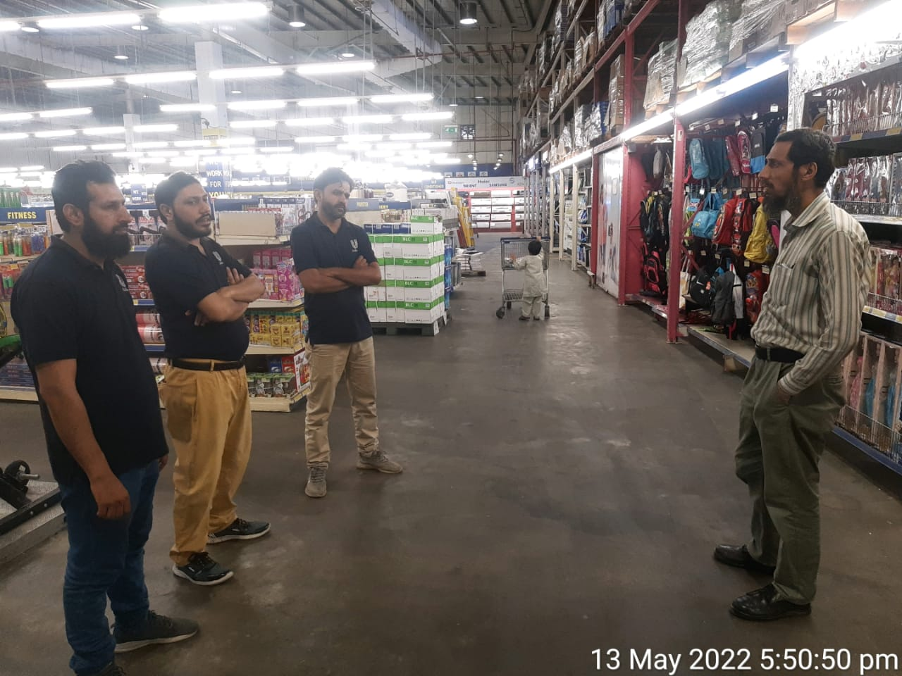
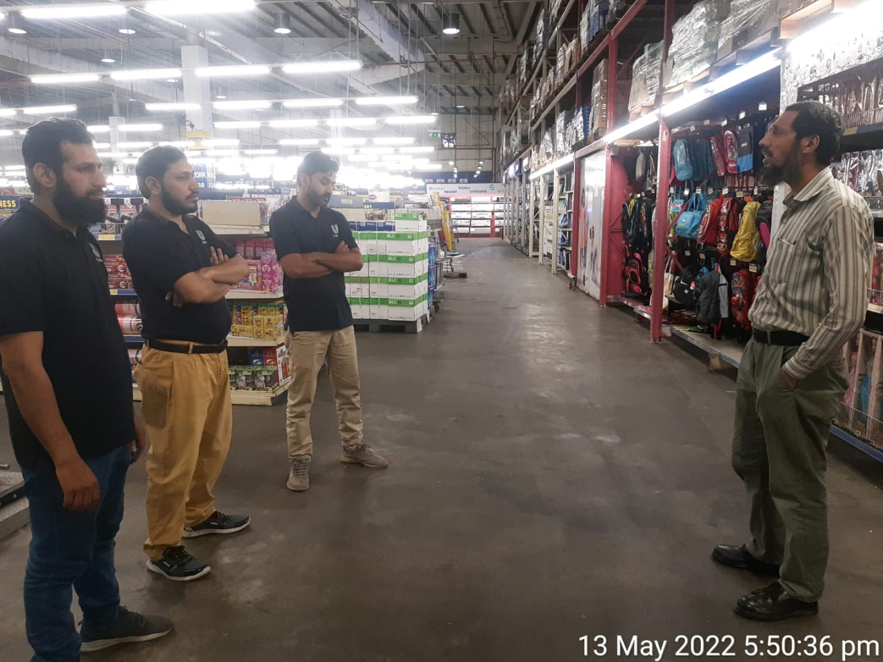
Metro Ravi 08.02.2022
GROOMING (Hair cutting, Shoes polish, Neat and clean uniform
SAFETY (Maintain Bike with HELMET, Fog light ,Side mirror, indicators
SAFETY IN STORE (Wear Mask, sanitizer use, Distance from lifter, social distance ,know about emergency exit
Smollan values
Stocks filling
Shelves cleaning
Missing raicard
Zero articles
Block articles

Slide 3
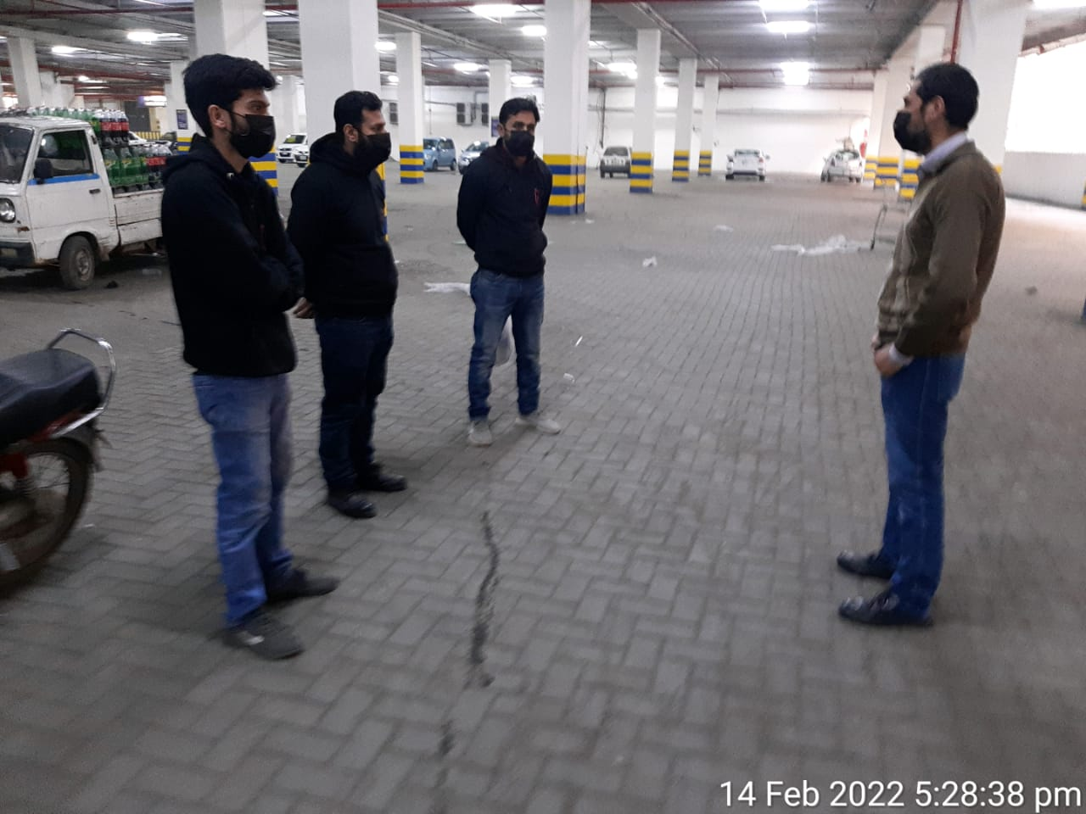
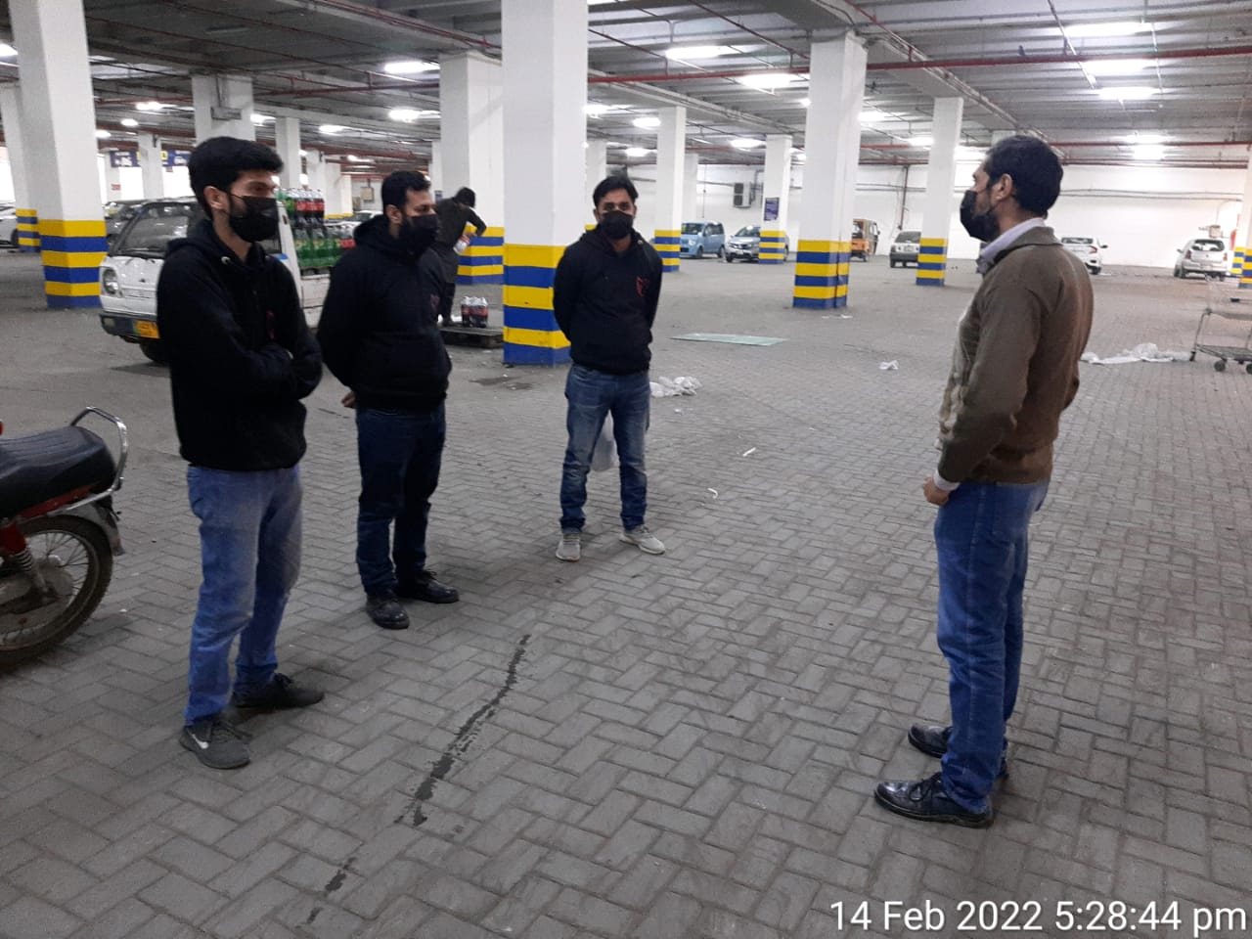
Metro Ravi 14.02.2022
GROOMING
(Hair cutting, Shoes polish, Neat and clean uniform
SAFETY IN STORE (Wear Mask, sanitizer use, Distance from lifter, social distance ,know about emergency exit
Smollan values
Stocks filling
Shelves cleaning
Missing raicard
Zero articles
Corona safety instruction

Slide 4
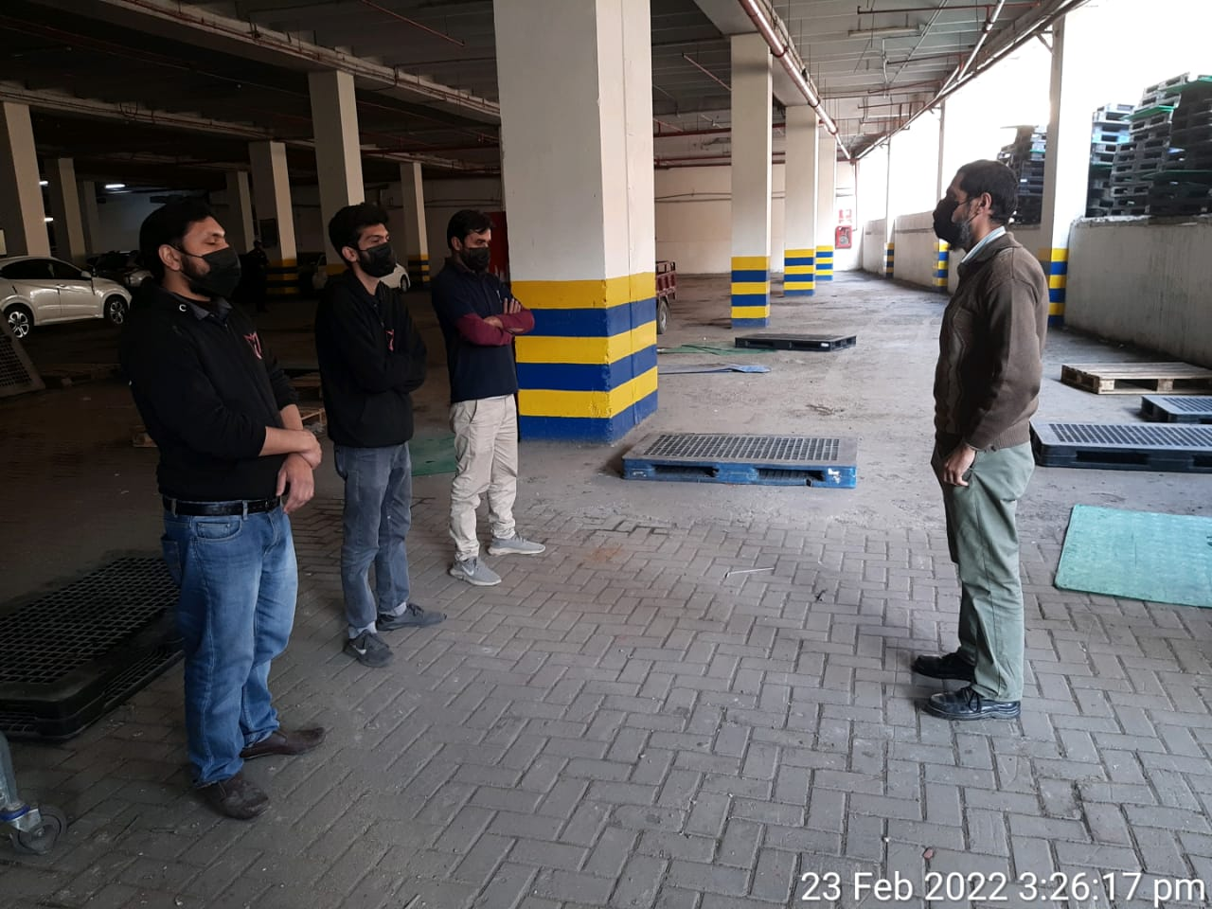
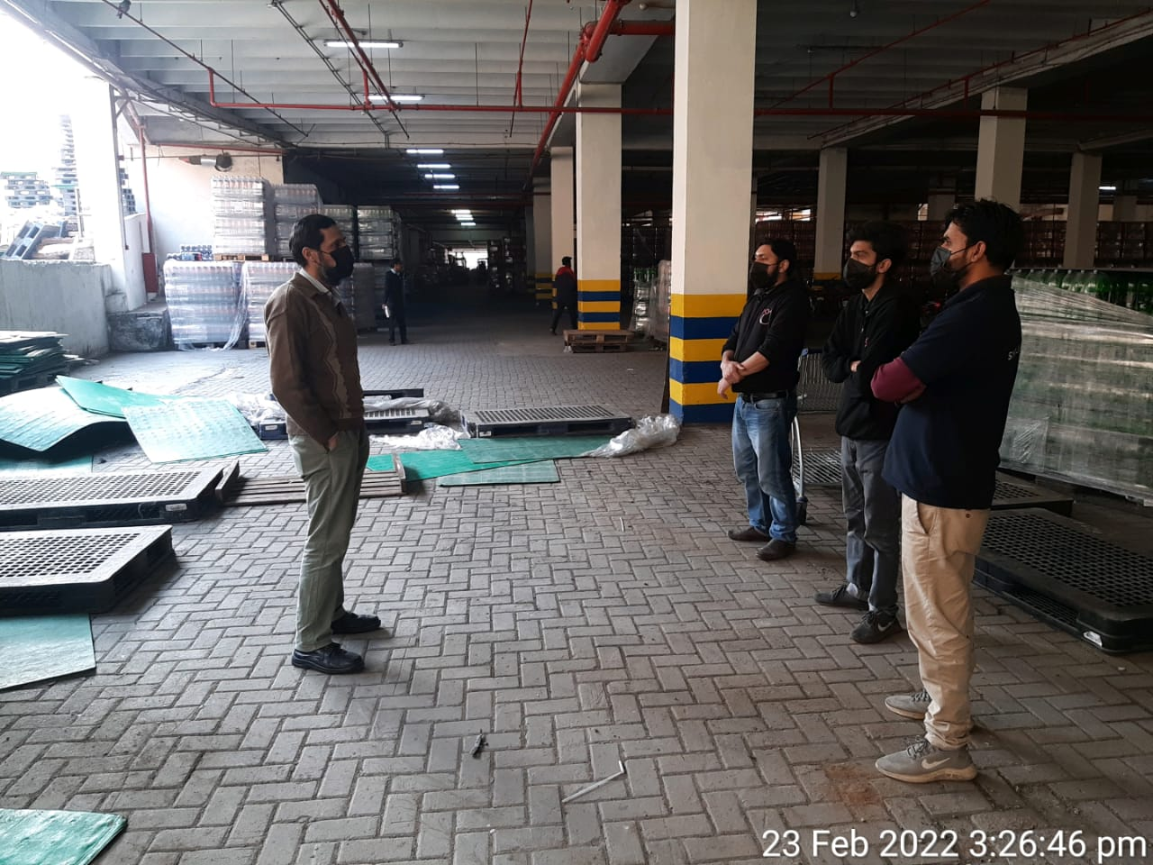
Metro Ravi 23.02.2022
Team meeting
Check Personal hygiene
Use mask and sanitizer
Proper attendance and Check in
Meet section staff Floor visit
Check missing label
Check FIFO
Follow up on near to expiry stock specially hellmmans 100 ml mayo
Product & shelf cleaning
Ware house organized

Slide 5
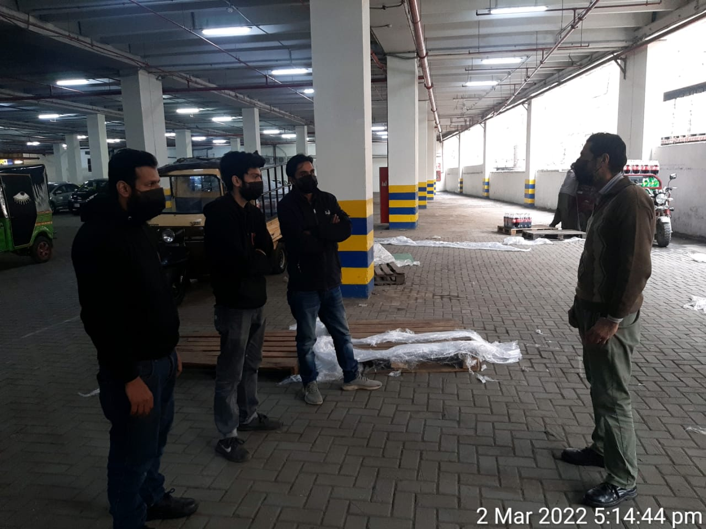
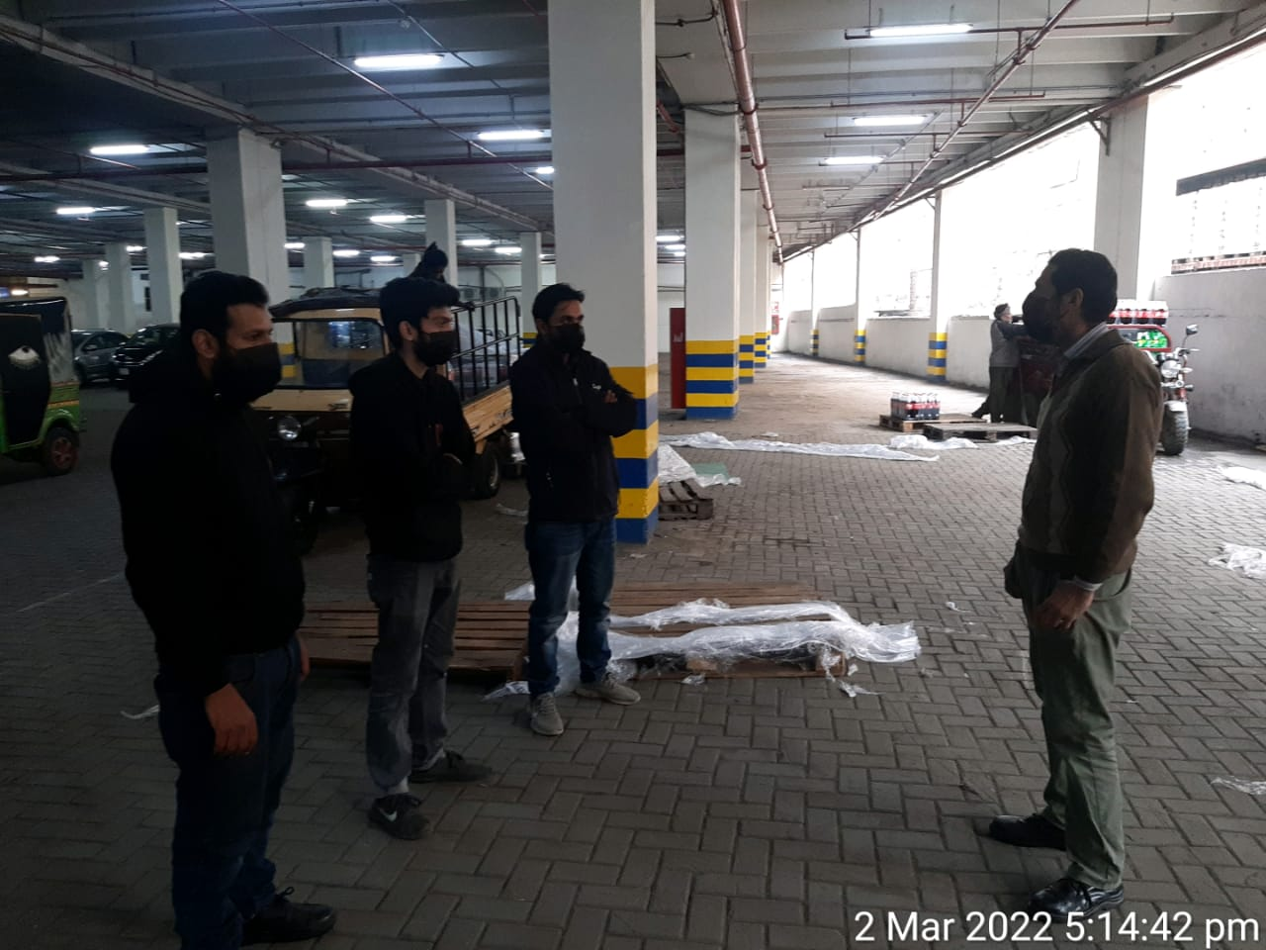
Metro Ravi 02.03.2022
GROOMING (Hair cutting, Shoes polish, Neat and clean uniform
SAFETY (Maintain Bike with HELMET, Fog light ,Side mirror, indicators
SAFETY IN STORE (Wear Mask, sanitizer use, Distance from lifter, social distance ,know about emergency exit
Smollan values
Discussion on short expiry articles and managing their stocks
Shelves cleaning
Missing raicard
Zero articles
Medical claims form filling

Slide 6
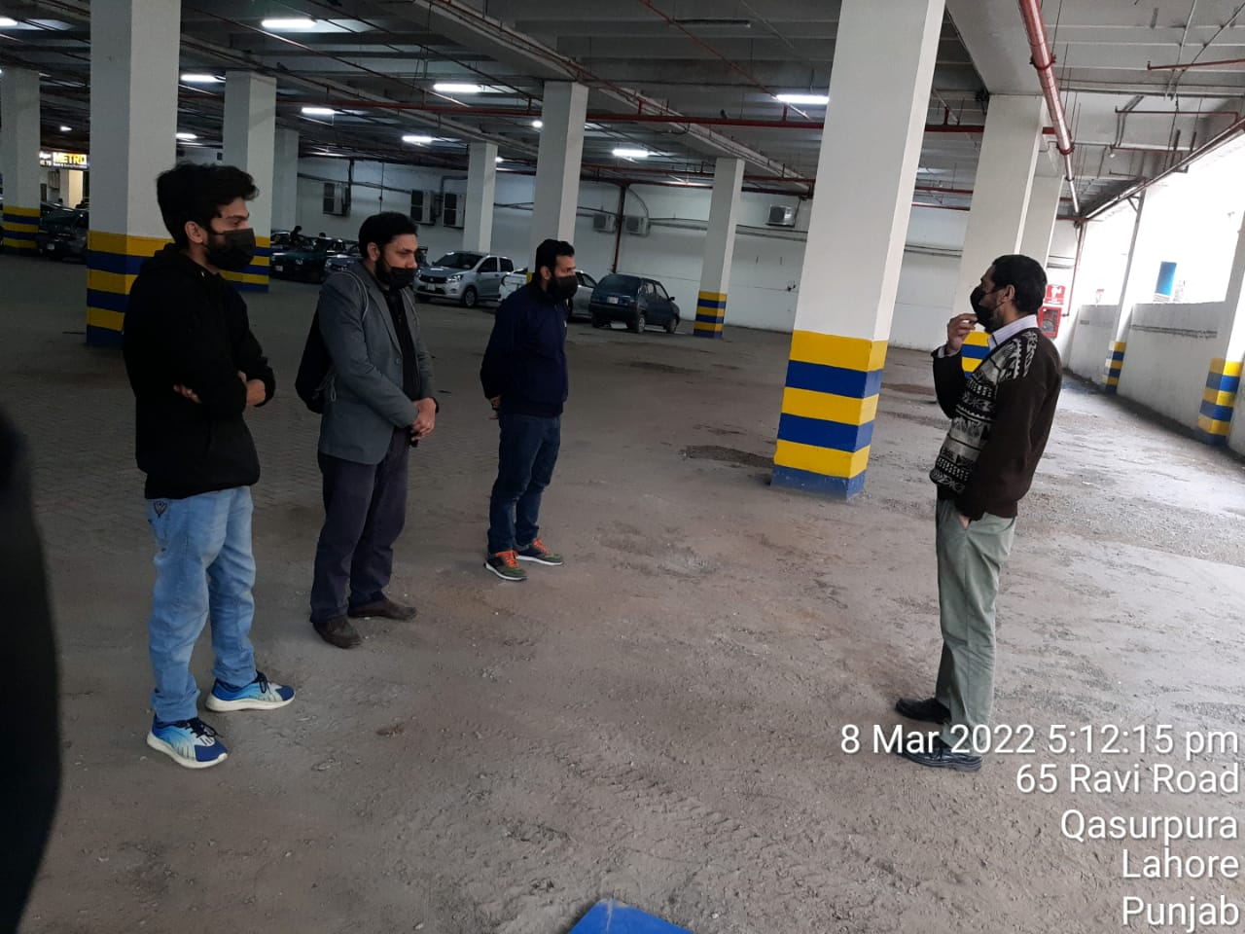
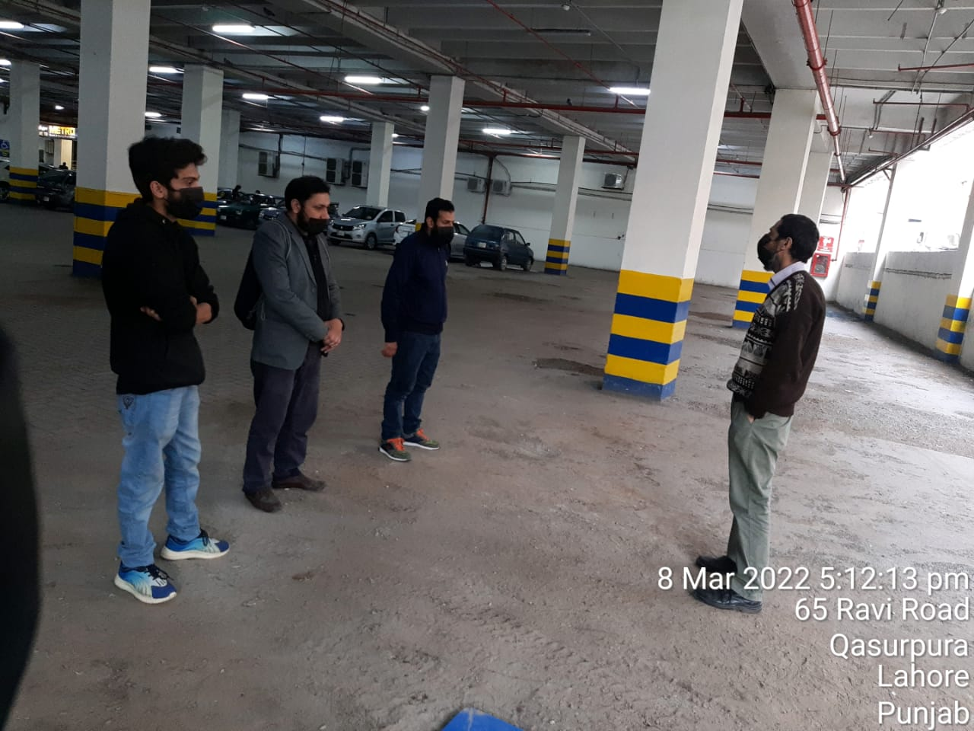
Metro Ravi 08.03.2022
Team meeting
Check Personal hygiene
Use mask and sanitizer
Proper attendance and Check in
Meet section staff Floor visit
Check missing label
Check FIFO
Follow up on near to expiry stock specially hellmmans 100 ml mayo
Product & shelf cleaning
Ware house organized

